Slide 1
Bellabeat fitness analysis
Author: Ben Robinson
Last updated: April 13th, 2024

Slide 2
Table of contents
Business Task
Summary of the data
Insights
Recommendations

Slide 3
Business Task
Our task was to analyze fitness data from users to gain insights into how they are using the app to guide the market analytics teams for the continued global growth of BellaBeat.

Slide 4
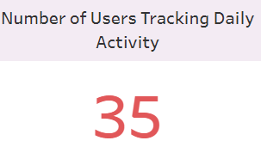
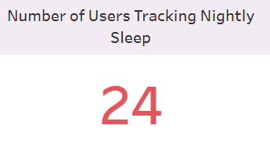
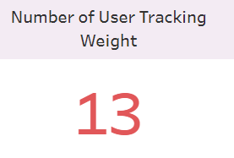
The data
The data was collected from users that consented for their information to be gathered and used.
This covers the time period of two months from March 12,2016 to May 12, 2016

Slide 5
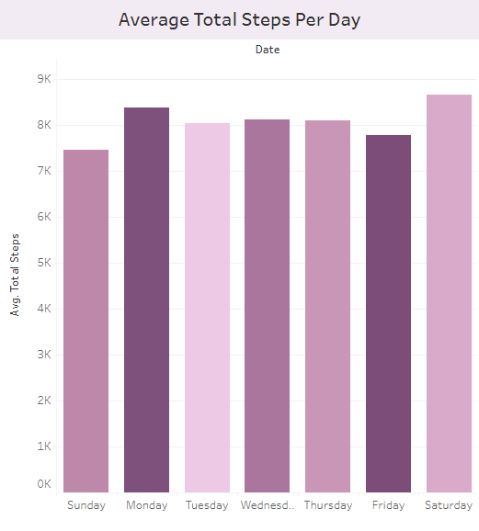
Insight 1
Looking at the average number of steps that are taken each day.
Lighter bars represent a lower average of sedentary minutes for that day.
Mondays and Saturdays show the most steps
Overall most users are getting the recommended number of steps (between 7500 and 10000)

Slide 6
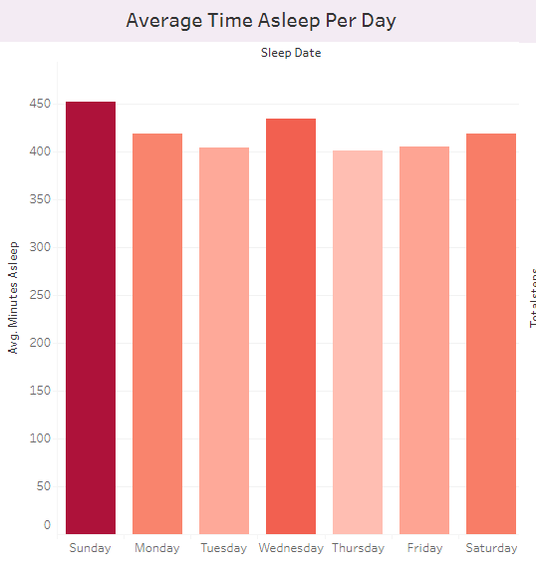
Insight 2
Looking at the average number of minutes of sleep per night.
The darker bars represent a higher number of minutes staying in bed
Sunday shows the highest amount of sleep
Most of the days they are not getting the recommended 7 hours (420 minutes) of sleep

Slide 7
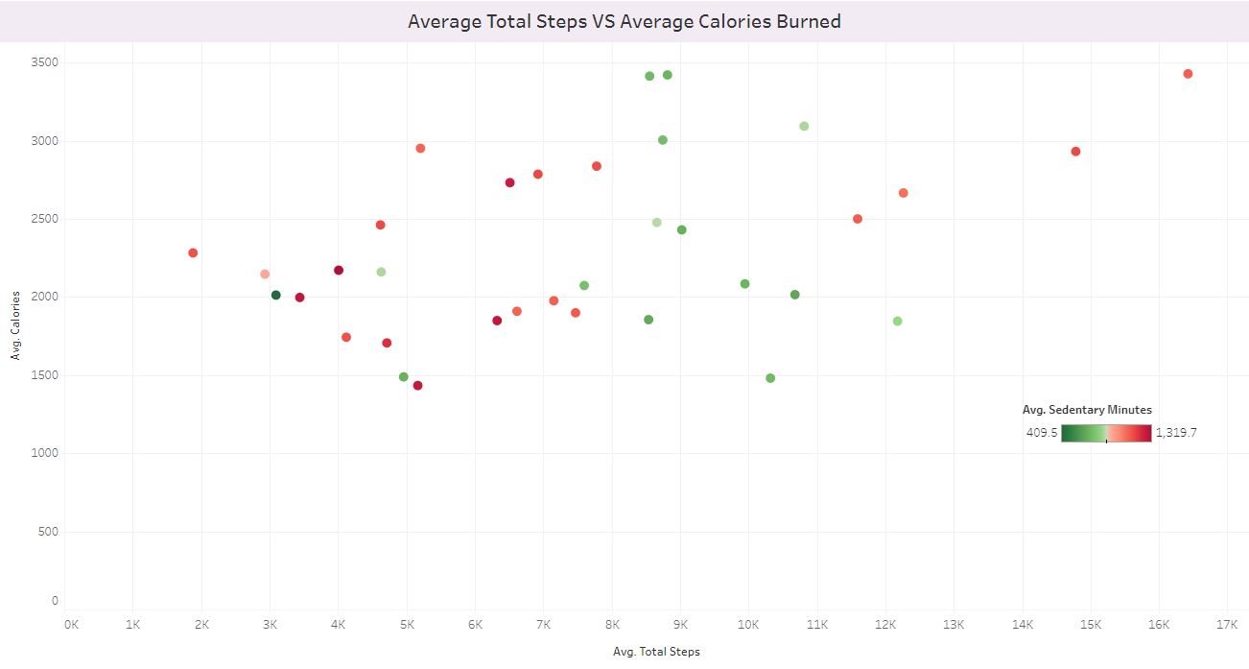
Insight 3
We can see a loose relationship between steps and calories burned.
See a split between higher sedentary minutes/lower steps and lower sedentary minutes/higher steps

Slide 8
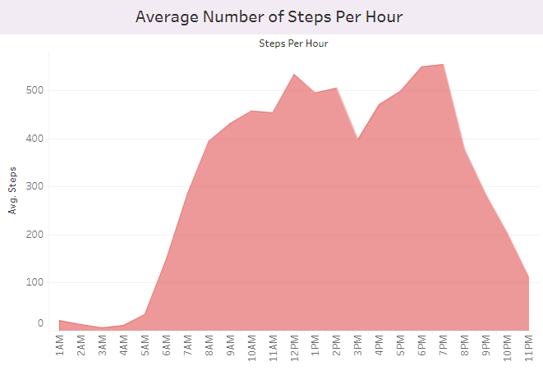
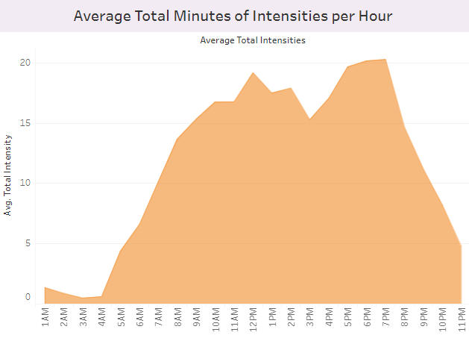
Insight 4
There is a clear pattern between the average minutes of intensities and the average number of steps taken each hour of the day

Slide 9
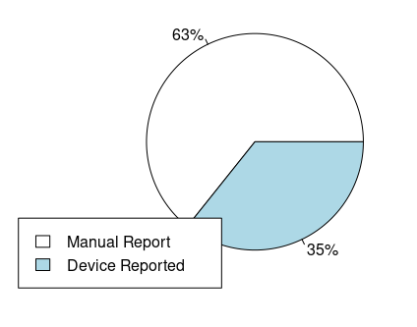
Insight 5
13 users tracked their weight
A high number of users manually enter their weight through the app

Slide 10
Recommendations
1) Daily notification to remind users to stay active:
There are a high level of sedentary minutes among users that could be cut down and increase steps.
2) Establish a sleep schedule:
On average the users showed to get under the recommended 7 hours of sleep per night. Allowing them to establish a sleep schedule with notifications for reminders.
3) Point/Reward system:
Allows the users to set goals and earn rewards to different related BellaBeat fitness tech to potentially expand brand item usage and ensure healthy habits.
Could incentivize tracking their weight through a BellaBeat affiliated device.

Slide 11
Thank you
Email: br6067@gmail.com
Data source: https://www.kaggle.com/datasets/arashnic/fitbit

